Slide 1

Activation Function
Artificial Neural Networks
Machine Learning

Slide 2
Activation Function
A mathematical function that is applied to the weighted sum of inputs before producing the final output of a neuron.
It introduces non-linearity, allowing the network to learn complex patterns.
Without activation function, a neural network would behave like a regression model.

Slide 3
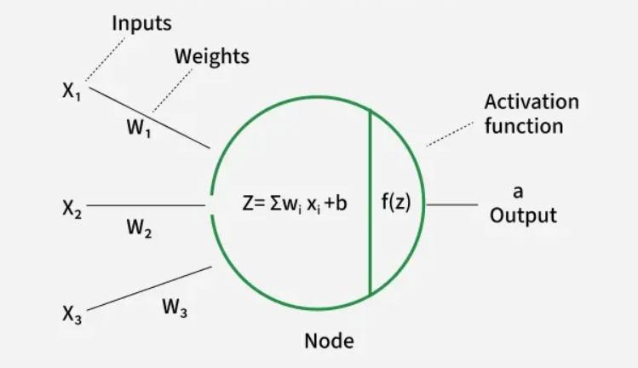

Slide 4
Importance of Non-Linearity
Real-world data is rarely linearly separable.
Non-linear functions allow neural networks to form curved decision boundaries, making them capable of handling complex patterns (e.g., classifying apples vs. bananas under varying colors and shapes).
They ensure networks can model advanced problems like image recognition, NLP and speech processing.

Slide 5
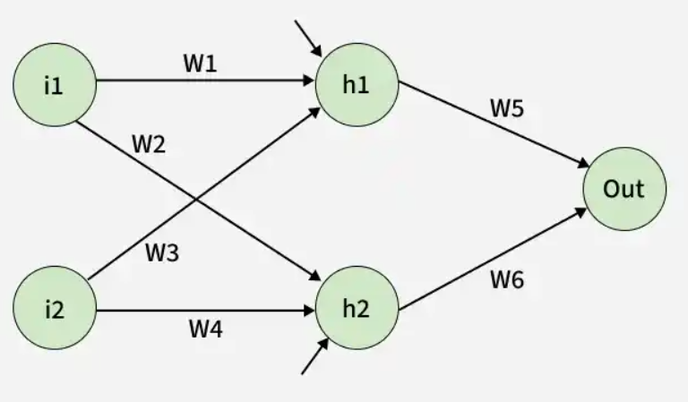

Slide 6
Types of Activation Functions
1. Sigmoid Function
2. Tanh Activation Function
3. ReLU(Rectified Linear Unit)Function
4. Leaky ReLU
5. Softmax

Slide 7
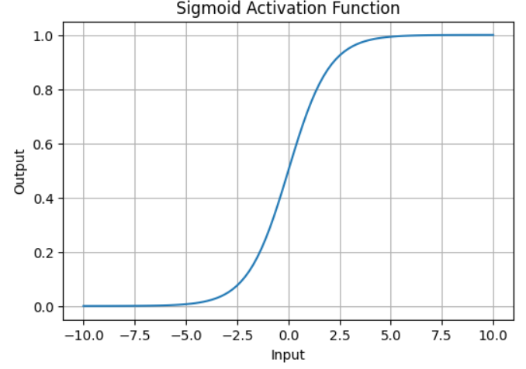
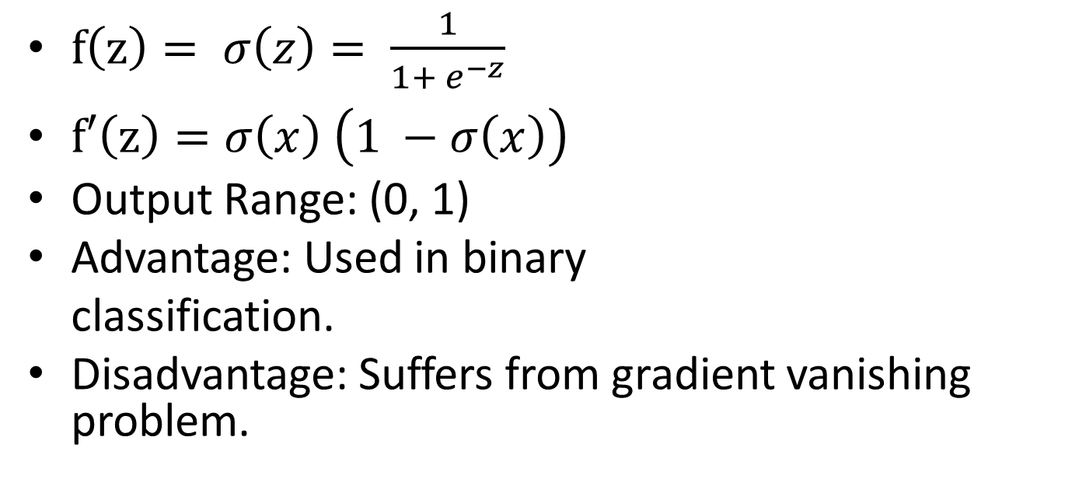
Sigmoid Activation Function
$f\left(z\right)= σ\left(z\right)= \frac{1}{1+ e^{−z}}$
$f′\left(z\right)=σ\left(x\right) \left(1 −σ\left(x\right)\right)$
Output Range: (0, 1)
Advantage: Used in binary
classification.
Disadvantage: Suffers from gradient vanishing problem.

Slide 8
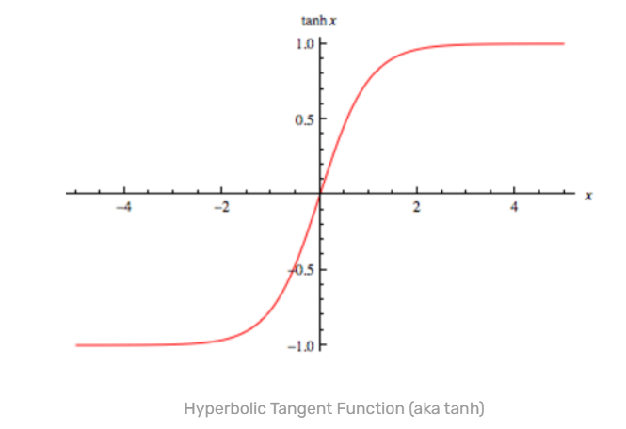
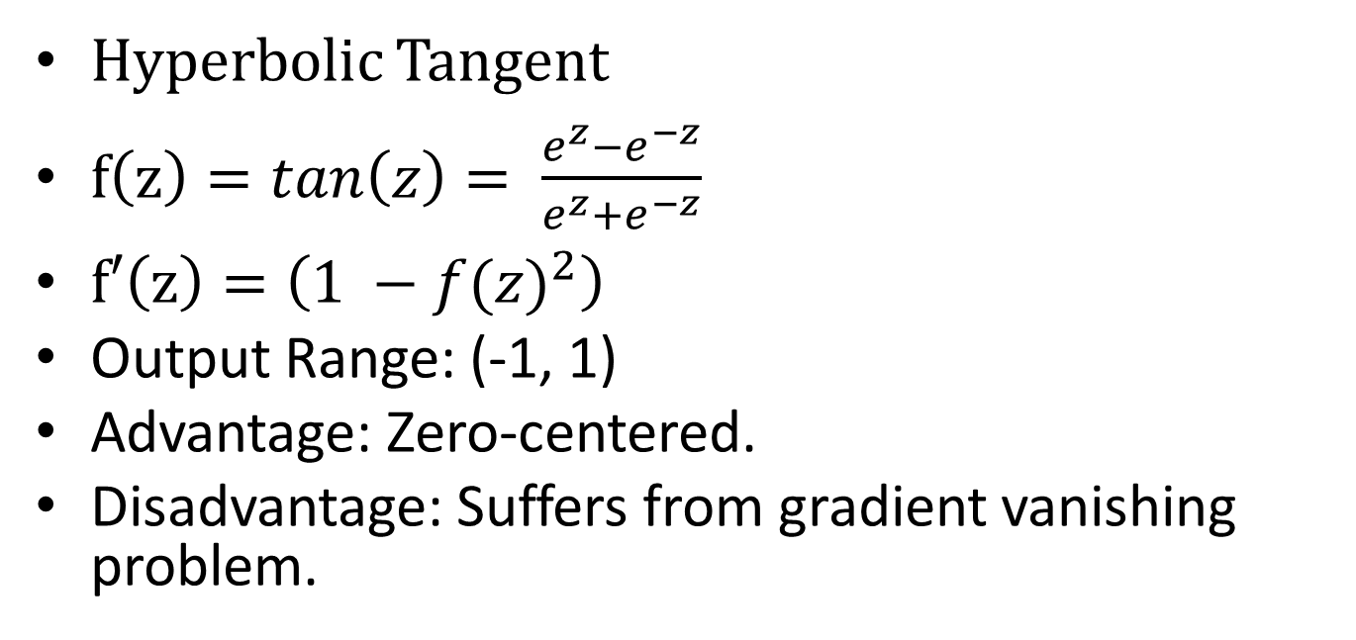
Tanh Activation Function
Hyperbolic Tangent
$f\left(z\right)=tan\left(z\right)= \frac{e^{z}−e^{−z}}{e^{z}+e^{−z}}$
$f′\left(z\right)=\left(1 −{f(z)}^{2}\right)$
Output Range: (-1, 1)
Advantage: Zero-centered.
Disadvantage: Suffers from gradient vanishing problem.

Slide 9
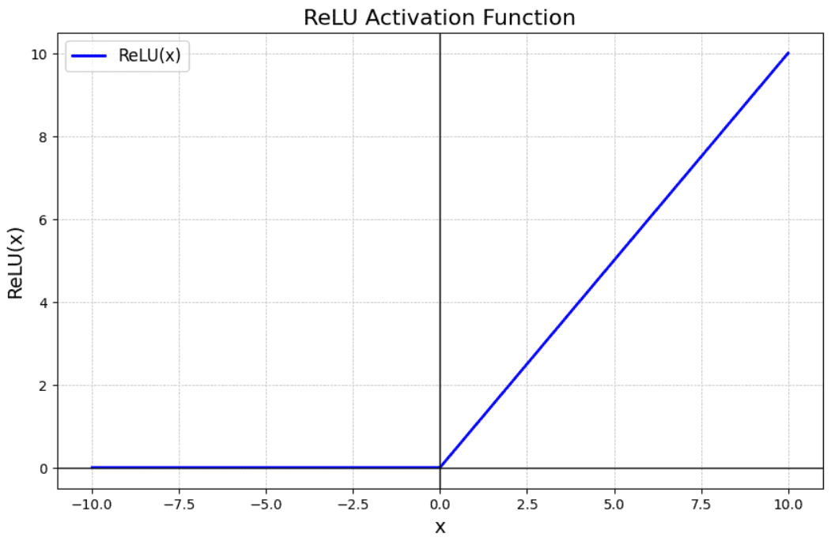
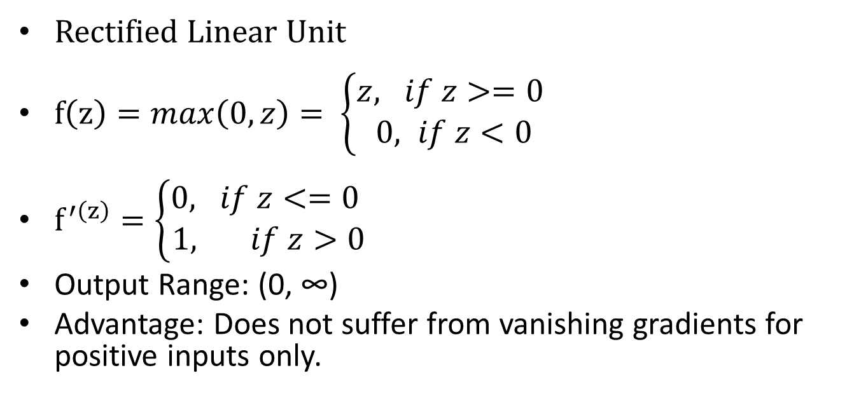
ReLU Activation Function
Rectified Linear Unit
$f\left(z\right)=max\left(0,z\right)= \left\{\begin{aligned}z, if z>=0 \\ 0, if z<0\end{aligned}\right.$
$f^{′\left(z\right)}=\left\{\begin{aligned}0, if z<=0 \\ 1, if z>0\end{aligned}\right.$
Output Range: (0, ∞)
Advantage: Does not suffer from vanishing gradients for positive inputs only.

Slide 10
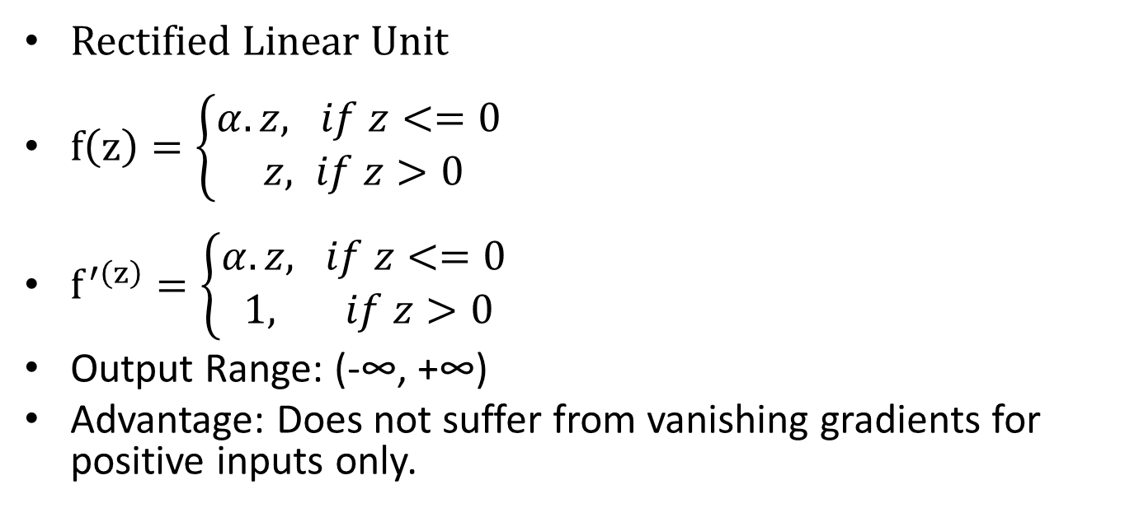
Leaky ReLU Activation Function
Rectified Linear Unit
$f\left(z\right)=\left\{\begin{aligned}α.z, if z<=0 \\ z, if z>0\end{aligned}\right.$
$f^{′\left(z\right)}=\left\{\begin{aligned}α.z, if z<=0 \\ 1, if z>0\end{aligned}\right.$
Output Range: (-∞, +∞)
Advantage: Does not suffer from vanishing gradients for positive inputs only.

Slide 11
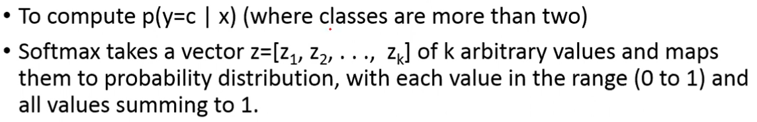
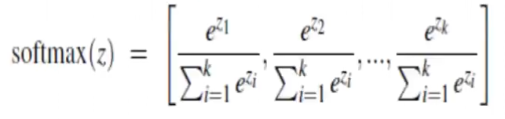
Softmax

Slide 12
Softmax: Example

Slide 13
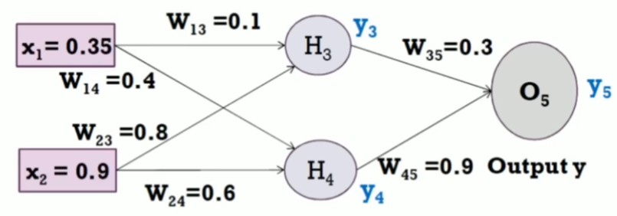
Example
Assume that the neurons have sigmoid activation function, perform a forward pass. Actual output y = 1.

Slide 14
Now, assume ReLU activation function on all neurons.

